Slide 1
Modal Verbs
English Class
Jiaxin Ruan
2-20-2013

Slide 2
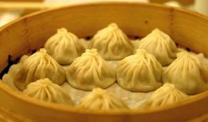
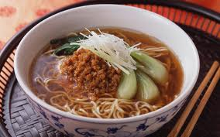
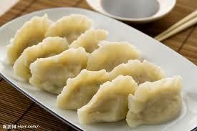
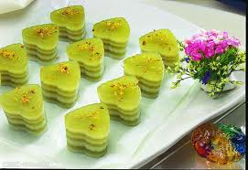
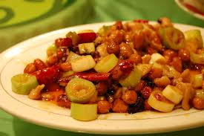
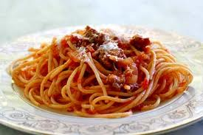
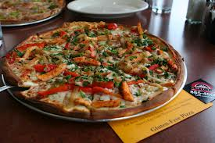
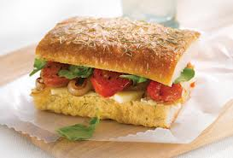
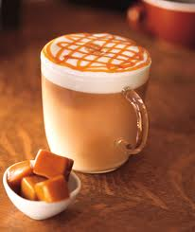
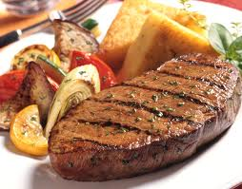
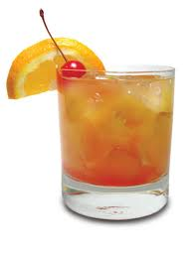
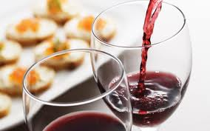
What is the food/drink’s name? What do they look like?

Slide 3
How to order food in Restaurant?
http://www.youtube.com/watch?v=RJsFReaPfzg
http://www.youtube.com/watch?v=qJbw5txb8GA

Slide 4
What kind of grammar rule do you notice in ordering food?

Slide 5
Using Modal Verbs to make request!
Rule of using modal verbs to make question:
Modal + subject + verb + (object)
“object” can be add depends on the situation

Slide 6
May: Ask for permission and request.
Examples:
May I eat the cake?
May I open the door?
May I have some water?

Slide 7
Can: represent ability of body and brain, and also possibility of events. Ask for permission.
Examples:
Can he write a short story?
Can I borrow your pen?
Can I have a cup of coffee?

Slide 8
Would: represent people’s idea.
Examples:
Would you like some tea?
What would like to order today?
I would like to have some paper towel.

Slide 9
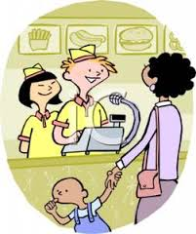
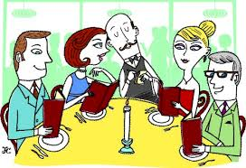
Ordering Food! According to the picture and write out a conversation. The conversation needs to include modal verbs. (Choose one of pictures)

Slide 10
Group Activity!!!

Slide 11
Menu:
Osmanthus rice cake
Xiao long bao
Tan Tan Mein
Dumpling
Kong Bao Chicken
Spaghetti
Pizza
Sandwich
Steak
Caramel Macchiato
Ice Tea
Wine

Slide 12
What did you order? Why? What is the taste of the item?

Slide 13
Different Forms of Modal Verbs
Different forms of can, may, would
Past tense negative
Can------ could-------- can not
Could: ability and possibility
Could you give me some paper?
I could catch the bus if I went to the bus stop earlier.
I cannot swim.
May-----might------- may not
Might: guess of past event
He might miss the train if he late five minutes.
He may not finish the test because there are too many questions that he doesn’t finish.
Will------would-------will not
Will: possibility of future or people’s idea
I will not eat fish because I hate it.
I will finish the homework by today.

Slide 14
Make Five sentences of Each Modal Verbs: can, may, would Modal Verbs can be in different form.

